Slide 1

ENHANCED ENTITY RELATIONSHIP MODEL [EER MODEL]
INFORMATION MANAGEMENT
CRIS NIEL BALOLOY
COURSE INSTRUCTOR

Slide 2
The following memes are intended for educational purposes only to convey a much deeper and easier understanding to the student about the topic.
Information Management
Module 1: Unit 3
EER-MODEL
DISCLAIMER

Slide 3
EER OVERVIEW
Information Management
Module 1: Unit 3
EER-MODEL

Slide 4

Information Management
UNIT 1: Module 2
EER-MODEL
ENHANCED ER DIAGRAM
ER DIAGRAM

Slide 5
Information Management
UNIT 1: Module 2
EER-MODEL
An Enhanced Entity-Relationship Diagram (EERD) is an advanced version of the traditional Entity-Relationship Diagram (ERD) used in database design. It visually represents the relationships between entities and attributes in a database. EERDs incorporate features like subtypes, supertypes, specialization, and generalization to model complex data scenarios, hierarchies, and distinctions more accurately. These diagrams are crucial in designing well-structured databases that can handle intricate data relationships and business rules, making them a valuable tool for database developers and analysts.

Slide 6
Purpose of EER Modeling
Information Management
Module 1: Unit 2
EER-MODEL

Slide 7
Information Management
UNIT 1: Module 2
EER-MODEL
The purpose of EER modeling is to create a comprehensive and flexible representation of data structures that accurately reflect the complexities of real-world systems. It ensures that databases are well-organized, maintain data integrity, and adapt to changing requirements while fostering effective communication among database design stakeholders.

Slide 8

Information Management
UNIT 1: Module 2
EER-MODEL
Improved Data Accuracy
EER modeling allows for the precise representation of complex data scenarios. It accommodates a wide range of relationships, hierarchies, and categories, resulting in more accurate database structures that mirror real-world complexities.
Enhanced Data Organization: EER modeling offers a more structured and organized approach to database design. It helps in classifying data into subtypes and supertypes, making it easier to manage and query information.
Complex Business Rules: EER modeling can capture and enforce complex business rules and constraints within the database structure. This ensures that data integrity and consistency are maintained.

Slide 9

Information Management
UNIT 1: Module 2
EER-MODEL
Efficient Querying: With a well-designed EER model, querying the database becomes more straightforward. The structured representation of data entities and their relationships allows for more efficient retrieval of information
Support for Specialization and Generalization: EER modeling supports the concepts of specialization (creating subtypes) and generalization (forming supertypes), making it particularly useful in situations where data entities have varying characteristics or where certain entities share common attributes.
Complexity:EER models can become quite complex, especially when dealing with multiple inheritance, recursive relationships, and various types of constraints. This complexity can make the model harder to understand and maintain.

Slide 10
EER CONCEPT [SUBTYPES AND SUPERTYPES]
Information Management
Module 1: Unit 2
EER-MODEL

Slide 11
Information Management
UNIT 1: Module 2
EER-MODEL
Supertype and Subtype
Supertype - an entity type that relates to one or more subtypes.
Subtype - a subgroup of entities with unique attributes.
Inheritance - the concept that subtype entities inherit the values of all supertype attributes.

Slide 12

Information Management
UNIT 1: Module 2
EER-MODEL
Entities with common Attributes
SUPERTYPE

Slide 13
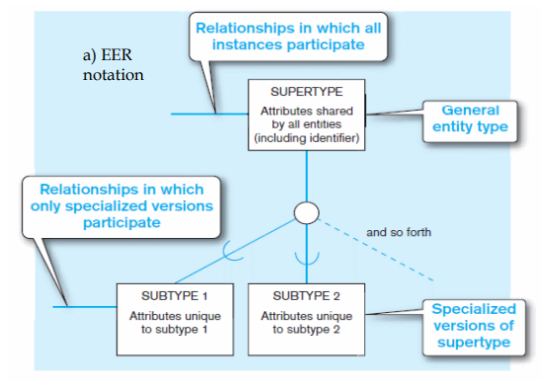
Information Management
UNIT 1: Module 2
EER-MODEL
BASIC NOTATION FOR SUPERTYPE AND SUBTYPE NOTATION
Chapter 3 the enhanced E-R model - villanova university. Available at: http://www.csc.villanova.edu/~mdamian/Past/databasefa11/notes/ch03-EER-Hand.pdf (Accessed: 26 October 2023).

Slide 14

Information Management
UNIT 1: Module 2
EER-MODEL
SUBTYPE 1
SUBTYPE 5
SUBTYPE 3
SUBTYPE 2
SUBTYPE 4
SUPERTYPE

Slide 15
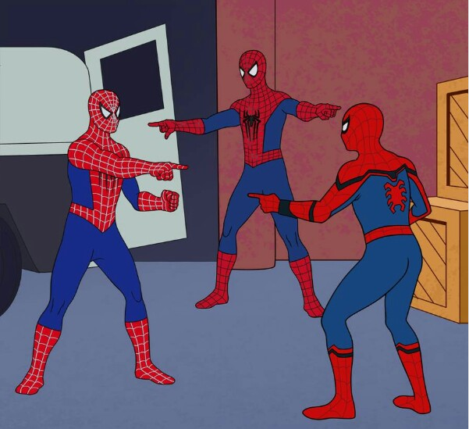
Information Management
UNIT 1: Module 2
EER-MODEL
Hourly employee
Employee-ID
Address
Date Hired
Hourly rate
Consultant employee
Employee-ID
Address
Date Hired Contract number
Billing Rate
Salaried employee
Employee-ID
Address
Date Hired monthly / annual rate
Stock Option

Slide 16
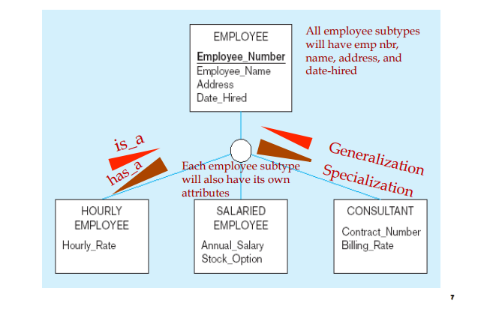
Information Management
UNIT 1: Module 2
EER-MODEL
Sample #1 Employee supertype with three subtypes
Chapter 3 the enhanced E-R model - villanova university. Available at: http://www.csc.villanova.edu/~mdamian/Past/databasefa11/notes/ch03-EER-Hand.pdf (Accessed: 26 October 2023).

Slide 17

Information Management
UNIT 1: Module 2
EER-MODEL
Sample Business Rule:
A Physician has an attribute of Physician ID , A physician must be capable of taking care of many Patient in a Hospital. A Patient belongs to different category. Outpatient that has an attribute of patient name , Admit date and checkback date. A resident patient that has an attribute of patient name , Admit date and date discharge
Every patient classified as a resident patient must be assigned to a hospital bed, and each bed may only be occupied by a single patient..
Bed has an attribute of Bed ID;

Slide 18
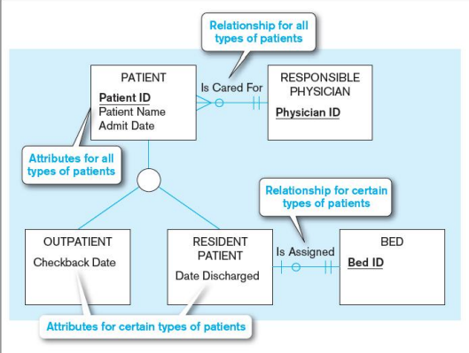
Information Management
UNIT 1: Module 2
EER-MODEL
GENERALIZATION : The process of defining a more general entity type from a set of more specialized entity types
SPECIALIZATION: The process of defining one or more subtypes of the supertype, and forming supertype/subtype relationships

Slide 19
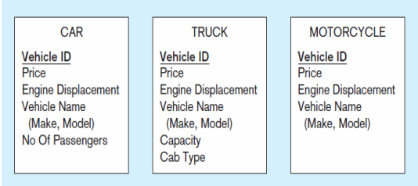
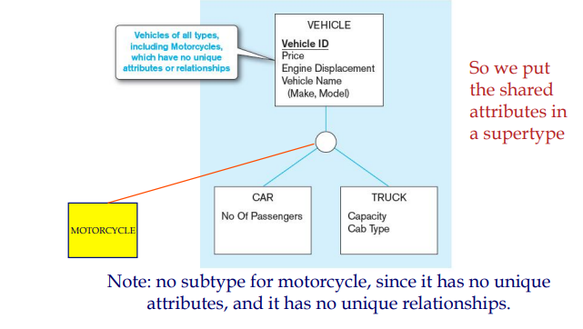
Information Management
UNIT 1: Module 2
EER-MODEL
Example of Generalization

Slide 20
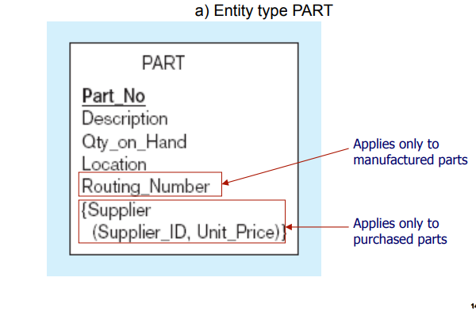
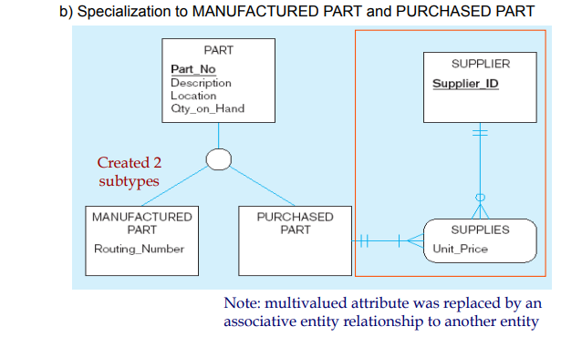
Information Management
UNIT 1: Module 2
EER-MODEL
Example of Specialization

Slide 21
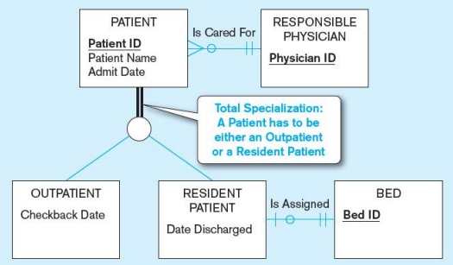
Information Management
UNIT 1: Module 2
EER-MODEL
Constraints in Supertype/ Subtypes Relationships
Completeness Constraints: Whether an instance of a supertype must also be a member of at least one subtype.
– Total Specialization Rule: (double line)
– Partial Specialization Rule: (single line)
Total Specialization Rule
The total specialization rule in entity-relationship modeling means that every entity in a subtype must be a part of the supertype. In simpler terms, it ensures that every subtype entity has to be associated with the supertype entity; there are no subtypes that exist on their own without a connection to the supertype.
Double line : every entity in the specialization hierarchy must belong to at least one subtype.

Slide 22
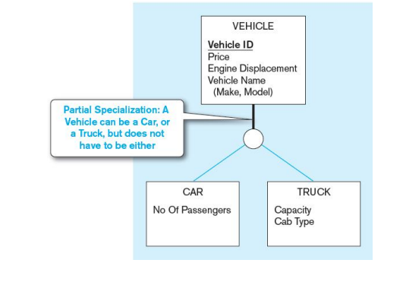
Information Management
UNIT 1: Module 2
EER-MODEL
Partial Specialization Rule
This rule applies when you are creating subtypes from a more general entity (supertype) through specialization. Partial specialization means that not all instances of the supertype are associated with a subtype. Some instances of the supertype remain "unclassified" or not associated with any subtype.

Slide 23
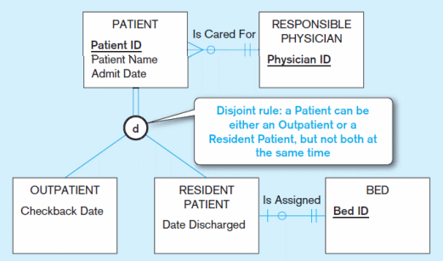
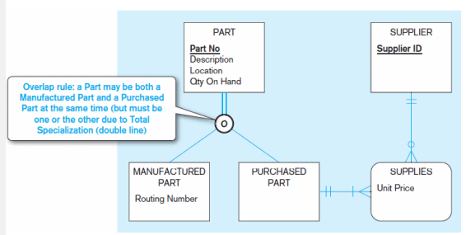
Information Management
UNIT 1: Module 2
EER-MODEL
Constraints in Supertype and Subtype Relationship
Disjointness Constraints : Whether an instance of a supertype may simultaneously be a member of two or more subtypes
Disjoint Rule : An instance of the supertype can be only ONE of the subtypes
Overlap Rule : An instance of the supertype could be more than of the subtypes
Example of Disjoint Rule
Example of Overlap Rule

Slide 24
Information Management
UNIT 1: Module 2
EER-MODEL
Disjoint Constraints In-depth
A DISJOINT CONSTRAINTS ONLY APPLIES WHEN A SUPERCLASS HAS MORE THAN ONE SUBCLASS. IF THE SUBCLASS ARE DISJOINT, THEN AN ENTITY OCCURANCE CAN BE A MEMBER OF ONLY ONE OF THE SUBCLASSES
EXAMPLE:
DEGREE HOLDER can be divided to postgrads or undergrads (ONE CANNOT BE BOTH)
To represent a disjoint supertype / subtype relationship OR is used

Slide 25
Information Management
UNIT 1: Module 2
EER-MODEL
Overlapping Constraints In-depth
THIS APPLIES WHEN AN ENTITY OCCURRENCE MAY BE A MEMBER OF MORE THAN ONE SUBCLASS.
EXAMPLE:
University Member can be a Staff and a Student at the same time.
AND is used to represent the overlapping relationship in the ER Diagram

Slide 26
Information Management
UNIT 1: Module 2
EER-MODEL
Completeness Constraints
TOTAL : Each superclass must belong to subclasses
Example:
A DEGREE HOLDER MUST BE A POSTGRAD OR UNDERGRAD
To represent a TOTAL Specialization Constraints MANDATORY KEYWORD IS USED
PARTIAL : Some superclass may not belong to subclass
SOME STUDENT FROM A UNIVERSITY ARE NETHIER STUDENT OR STAFF
The Keyword is optional to represent a Partial Specialization

Slide 27
Assessment
Information Management
Module 1: Unit 2
EER-MODEL

Slide 28
Information Management
UNIT 1: Module 2
EER-MODEL
Activity 1
An employee is divided into further groups :
Secretary ,Engineer, and IT Technician
Secretary : Employee_ID, Name, Age, Human Resource
Engineer : Employee_ID, Name, Age, Infrastructure, Research
IT Technician : Employee_ID, Name, Age, IT Department, Development
Assume that employee must be a member of exactly one of these subtypes.

Slide 29
Information Management
UNIT 1: Module 2
EER-MODEL
Activity 1
2. A Driver has 3 subcategories
Company Driver : LicenseNumber, Name, Age, Bldg Number
Family Driver : LicenseNumber, Name, Age, House Number
Private Driver : LicenseNumber, Name, Age
Business Rule:
Assume that a driver can drive different type of vehicle for different type of person
A private Driver must belong to one person only

Slide 30
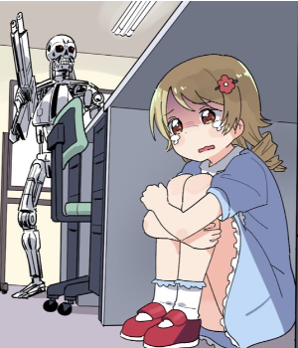
Information Management
UNIT 1: Module 2
EER-MODEL
EER DIAGRAM
“The choice between ER and EER modeling should be based on the requirements of the system, the skills of the development team, and the compatibility with the chosen DBMS”
IT STUDENT

Slide 31
Hierarchies, Lattice
Information Management
Module 1: Unit 2
EER-MODEL

Slide 32
The following images are intended for educational purposes only to convey a much deeper and easier understanding to the student about the topic.
Information Management
Module 1: Unit 3
EER-MODEL
DISCLAIMER

Slide 33

Information Management
UNIT 1: Module 2
EER-MODEL
HIERARCHY
Has a constraint that every subtype has only one supertype / Subtype
“Single Inheritance”
Supertype
Subtype
Supertype
Subtype
Hierarchies

Slide 34
Information Management
UNIT 1: Module 2
EER-MODEL
EMPLOYEE
Secretary
IT
Subtype
This relationship is typically used to model a "part-of" or "is-a" relationship, where the parent entity is a higher-level category that contains or encompasses the child entities.

Slide 35

Information Management
UNIT 1: Module 2
EER-MODEL
SPECIALIZATION LATTICE
A subclass can be subclass of more than one superclass
“multiple inheritance / shared subclass”
Employee
Supertype
Subclass
d
d
Secretary
Web Developer
Regular Employee
Hourly Employee
Employee has a subtype of roles, Secretary and a Web developer. An employee must be either Secretary or a web developer( total specialization and disjoint constraints)
Employees have various options for how they will get paid, Regular employee and Hourly employee(total specialization and disjoint constraints) Since a single employee cannot be a regular and hourly at the same time
IT Manager
Let's assume, that there is one employee that can do the task of the web developer and compensated as regular employee …… An IT Manager
A specialization lattice of an employee database

Slide 36
UNION
Information Management
Module 1: Unit 2
EER-MODEL

Slide 37
Information Management
UNIT 1: Module 2
EER-MODEL
UNION type or category.
A Category or Union represents a single super-class or sub-class relationship with multiple super-classes. Participation can be total or partial. In simpler terms, it represents an “either” type of relationship.
For example, The Car Owner in the Car booking model can be a Person, a bank, or a company.
The Owner is the union of the three superclasses Company, Bank, and Person. A member of a Category must exist in at least one of its superclasses.
Supertype
Subclass
Subtype
PERSON
BANK
PERSON
BANK
COMPANY
COMPANY
u
OWNER
OWNER

Slide 38
Information Management
UNIT 1: Module 2
EER-MODEL
SPECIALIZATION LATTICE with Union Category
Employee
Supertype
Subclass
d
d
Secretary
Web Developer
Regular Employee
Hourly Employee
u
IT Manager
A specialization lattice of an employee database

Slide 39
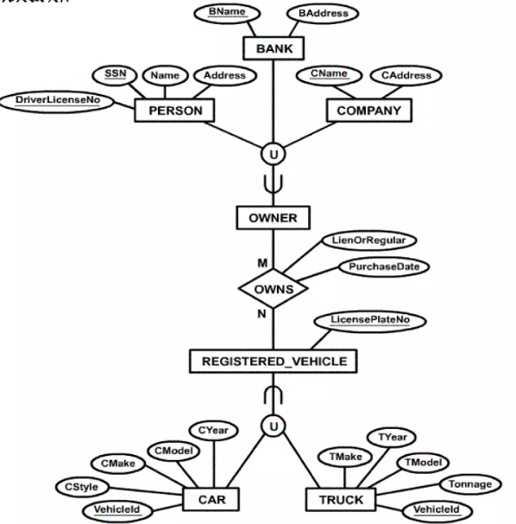
Information Management
UNIT 1: Module 2
EER-MODEL
UNION of OWNER AND REGISTERED VEHICLE
Supertype
Subclass
Subtype

Slide 40
Information Management
UNIT 1: Module 2
EER-MODEL
Sample Business Rules
“A person might be an employee, alumnus, and a student”
Person(Name ,Age ,Gender, Birthdate)
Employee(Salary, Employee-ID)
Alumnus (Degree)
Student (Student-id, Major)
“An employee is either a Staff, Faculty or student assistant but not both at the same time”
Utility Staff (Position)
Faculty (Specialization)
Student Assistant (Shift Time, Major)
“A student can be an Undergraduate student and student assistant at the same time “
Undergraduate(Subject)
"A student assistant can be either a technical assistant or a library assistant, but not both."
Technical Assistant (Laboratory-Handle)
Library assistant (Book Responsibilities)
Supertype
Subclass
Subtype

